Slide 1

Design & Develop Classroom Portal
Final Evaluation
Presenter
Nihar Zutshi
Guide
Mr Arjun Puri
DEPARTMENT OF COMPUTER SCIENCE AND ENGINEERING
MIET(Autonomous), JAMMU

Slide 2



ENGINEERING
PROJECT
PROPOSAL
Nihar Zutshi 191203088

Slide 3
ABOUT THE PROJECT
01
MAJOR REQUIREMENTS
02
TABLE OF CONTENTS
PROJECT GOALS
03
Project Overview
04
Team
05

Slide 4

OUR COMPANY

Slide 5
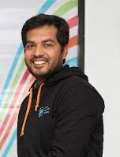
Project Mentor
Dr. Koushlendra Kumar Singh
Assistant Professor
Department of Computer Science and Engineering,
National Institute of Technology Jamshedpur, Jharkhand
(An Institute of National Importance, Established by GoI)

Slide 6

ABOUT THE PROJECT
During our project we built the Online courses teach students how to manage their time better since the student bears the responsibility of engaging with the course instead of simply showing up to class on an assigned day and time.

Slide 7
TIMELINE
DAY 13
DAY 59
Designing and Implementation
Final Project with Few Improvement
DAY 1
DAY 39
Learning & Understanding the Project
Project Review and Bug Fixing

Slide 8
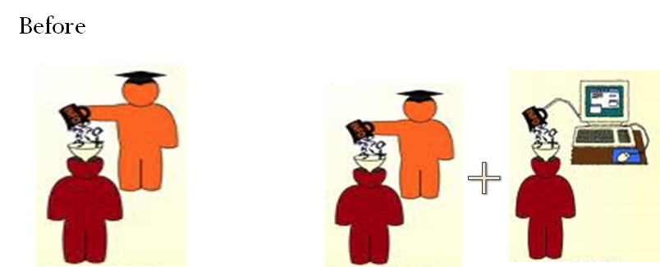
A Comparison
Back
Now

Slide 9
Design
Develop
WHAT WE ARE WORKING ON
Classroom
Portal
Stage 1
Stage 2
DESIGN AND DEVELOP CLASSROOM PORTAL
Notes:
Stage 1 & Stage 2

Slide 10


GOAL 1
PROJECT GOALS
GOAL 2
Classroom management is how teachers influence student behavior to create an environment conducive to learning. The primary goal is to maximize appropriate conduct and minimize student misbehavior.
Learning management system (LMS) that aims to simplify creating, distributing, and grading assignments and engaging students in learning online or remotely

Slide 11

A BRIEF HISTORY OF ONLINE EDUCATION
Long before the internet was launched, distance courses were being offered to provide students with education on particular subjects or skills.
Notes:
The first online learning systems were really only set up to deliver information to students but as we entered the 70s online learning started to become more interactive. In Britain, the Open University was keen to take advantage of e-learning.

Slide 12
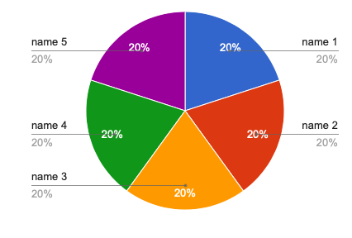
Less expensive than traditional teaching methods
20%
Vast variety of available courses
PROJECT OVERVIEW
MERCURY
10%
Standardized quality
20%
Flexibility
20%
Much less
infrastructure required
20%
Standardized quality
20%
Notes:
Online learning is booming in current times. Aided by the widespread availability of high-speed internet, making use of new technologies such as 4G and the soon-to-be-released 5G, online learning is expected to grow by leaps and bounds in the foreseeable future. The worldwide market size of online learning is approximately $187.87 billion in 2019, a 400% increase over what it was just six years ago

Slide 13





Major Competitors of our Project’s
More…
Notes:
Google Classroom:- 675 Per Month Charges - 1250 Per Month Depending upon the students 1. Canvas LMS is the LMS that makes teaching and learning (and implementation and adoption and customer support and student success and bragging to your non-Canvas-using peers) easier. - Slower to reach roi - More expensive 2) Blackboard Learn is a scalable, reliable foundation for a world-class learning experience. Our flexible learning platform enables you to extend online learning, increase engagement and optimize learning outcomes.
Slower to reach roi
More expensive
3) Talent LMS:- TalentLMS is a super-easy, cloud LMS to train your employees, partners and customers. More expensive. Starter $ 60, 149, 279
Easier to do business with
Better at support
4) Canvas LMS is the LMS that makes teaching and learning (and implementation and adoption and customer support and student success and bragging to your non-Canvas-using peers) easier. - Slower to reach roi
More expensive
Google Classroom:- Classroom is a tool in Google Apps for Education that helps teachers create and organize assignments quickly, provide feedback efficiently, and easily communicate with their classes.

Slide 14
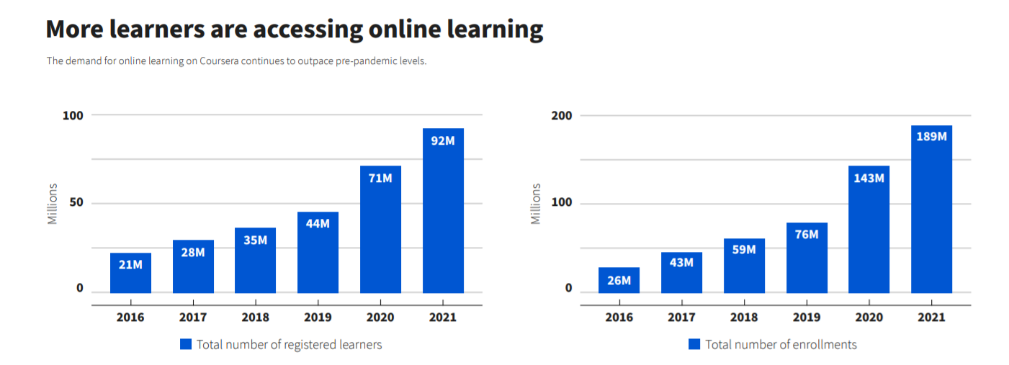
More Learners Are Accessing Online Learning
The demand for online learning continues pre-pandemic levels
GRAPH
Reference from World Economics Form’s
Notes:
In 2016, 21 million students registered for Coursera’s online courses, a number that increased annually by around 7 million over the next two years. But the switch to remote working as the pandemic hit triggered a three-fold increase in new registrations, bringing the figure to 71 million in 2020, and 92 million in 2021.
Course enrolments for online learning followed a similar pattern, with pre-pandemic gains overshadowed by huge spikes. Enrolment numbers more than doubled in 2020 and increased by 32% the following year, peaking at 189 million. These increases reflect growing global acceptance of online teaching, including increases in remote learners taking higher education courses and those from vulnerable or remote communities.

Slide 15
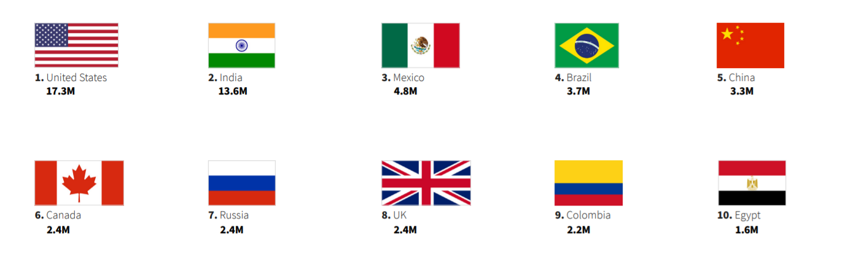
Top 10 Countries with the most learner’s
Learners from around the world come to build critical skills
Reference from World Economics Form’s
Notes:
At the country level, the US topped the standings with more than 17 million people getting enrolled in online learning, followed by India with 13.6 million. A sizable gap separated these two nations from Mexico with almost 5 million, with Brazil and China completing the top five list.

Slide 16

What Next?

Slide 17
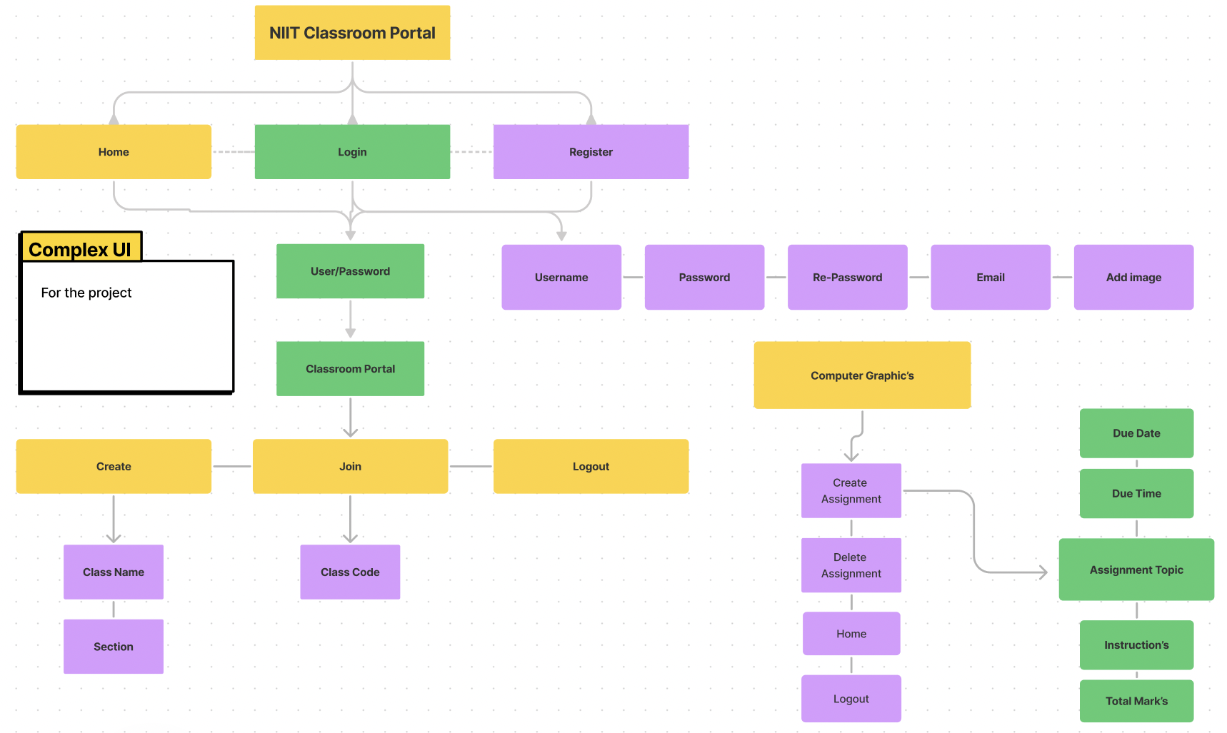
PROTOTYPE
Mercury is the closest planet to the Sun and the smallest one in our Solar System—it’s only a bit larger than our Moon. The planet’s name has nothing to do with the liquid metal, since it was named after the Roman messenger god

Slide 18
Front End
CSS, JavaScript, Django, React
TECHNOLOGY STACK
Back End
Python, JavaScript, SQL

Slide 19
Asgiref
Mock
TECHNOLOGY ENVIRONMENT
Freezeegun
Sqlparse
Whitenoise
Pytz
Notes:
What is an ASGI framework?
ASGI (Asynchronous Server Gateway Interface) is a spiritual successor to WSGI, intended to provide a standard interface between async-capable Python web servers, frameworks, and applications.
Brotli compression
Whitenoise (Django framework)
As well as the common gzip compression format, - WhiteNoise supports the newer, more efficient brotli format. This helps reduce bandwidth and increase loading speed. To enable brotli compression you will need the Brotli Python package installed by running pip install whitenoise[brotli] .

Slide 20

DOUBT?
Freezegun
Notes:
Might be thing this about the freezegun

Slide 21
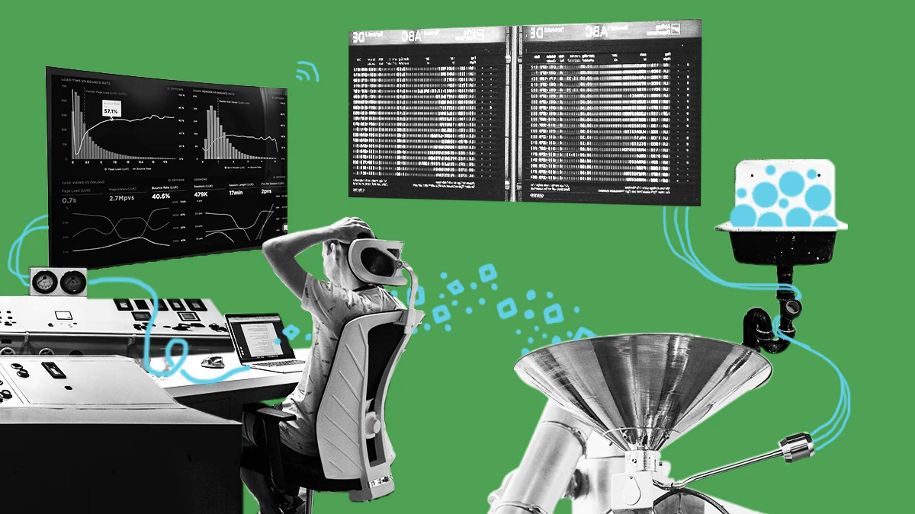
Freezegun
FreezeGun is a library that allows your python tests to travel through time by mocking the datetime module.
Notes:
Once the decorator or context manager have been invoked, all calls to datetime.datetime.now(), datetime.datetime.utcnow(), datetime.date.today(), time.time(), time.localtime(), time.gmtime(), and time.strftime() will return the time that has been frozen. time.monotonic() and time.perf_counter() will also be frozen, but as usual it makes no guarantees about their absolute value, only their changes over time.

Slide 22
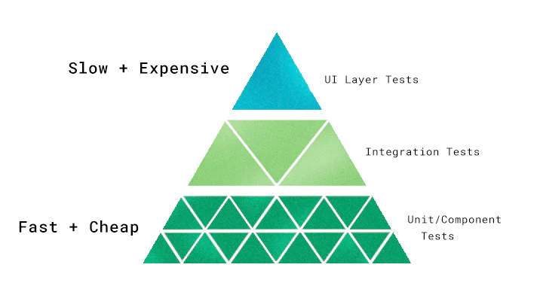
Mock
Mocking means creating a fake version of an external or internal service that can stand in for the real one, helping your tests run more quickly and more reliably.

Slide 23
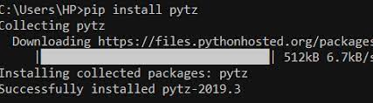
Pytz
- Pytz brings the Olson tz database into Python and thus supports almost all time zones. This module serves the date-time conversion functionalities and helps user serving international client’s base. - It enables time-zone calculations in our Python applications and also allows us to create timezone aware datetime instances.
Notes:
What is OLson? the tz database is a collaborative compilation of information about the world's time zones, primarily intended for use with computer programs and operating systems.

Slide 24
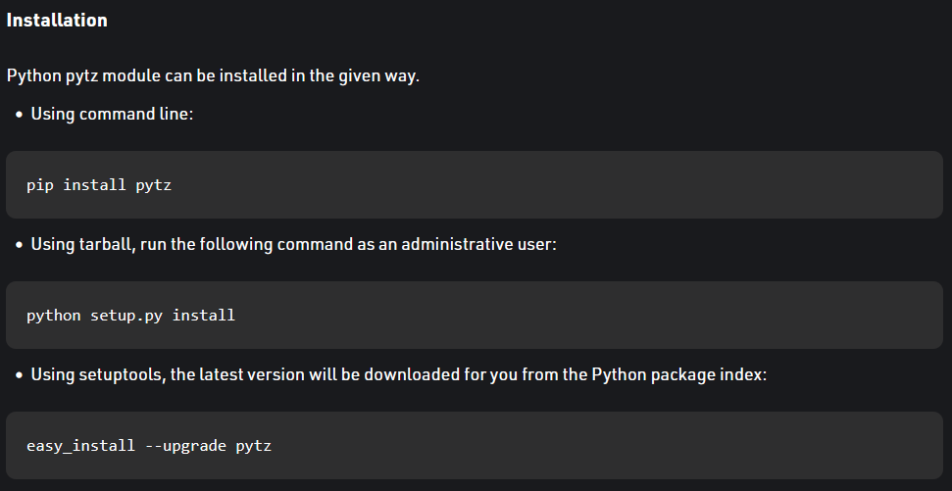

Slide 25
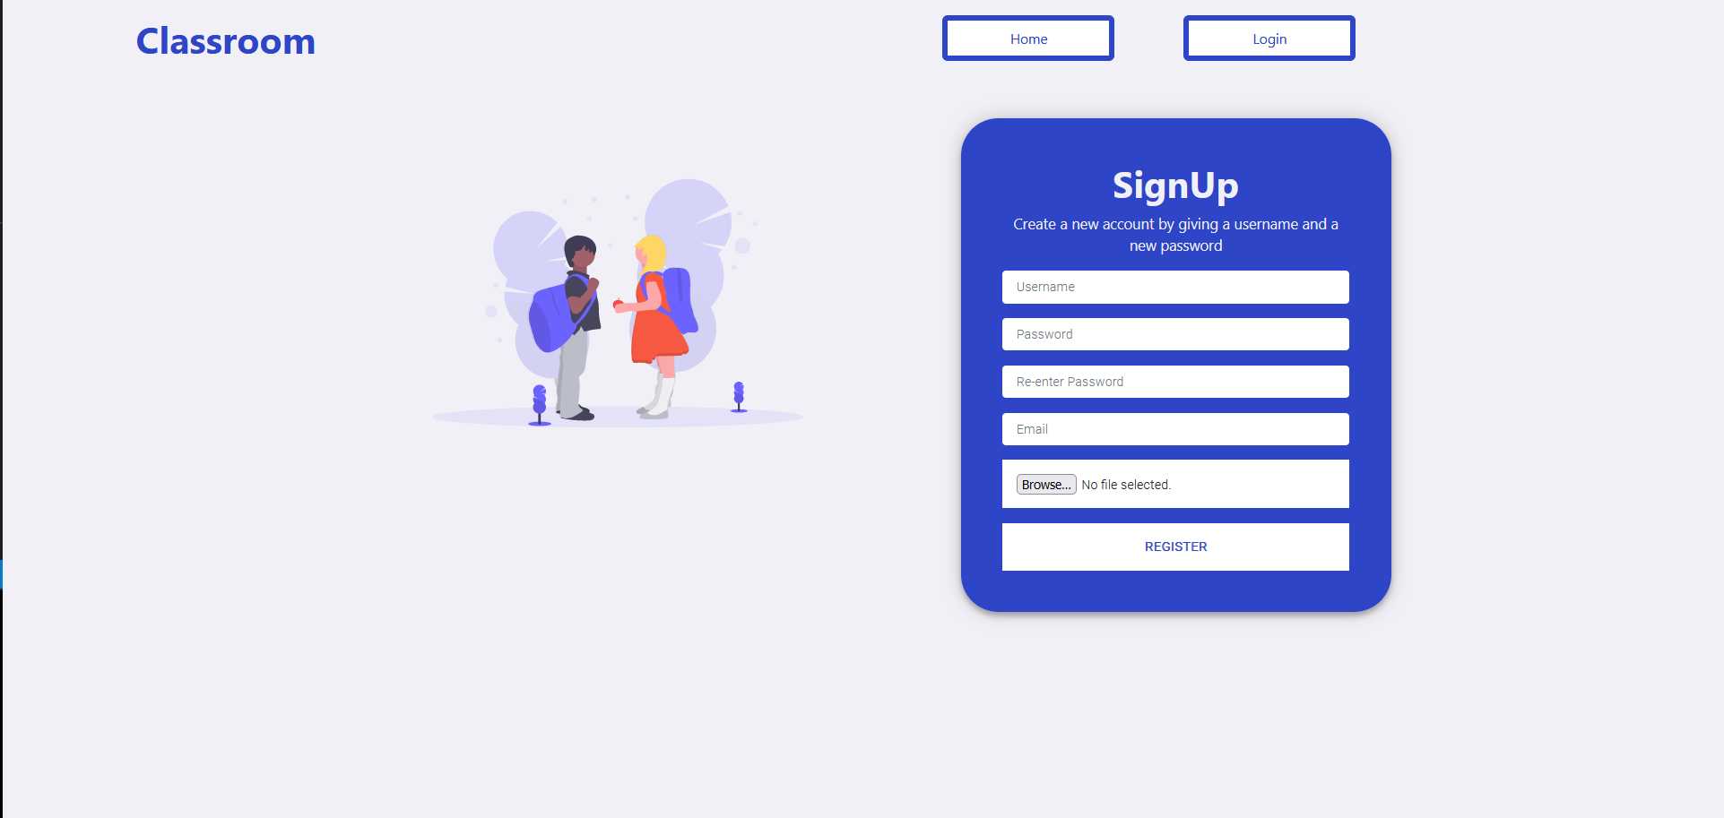

Slide 26
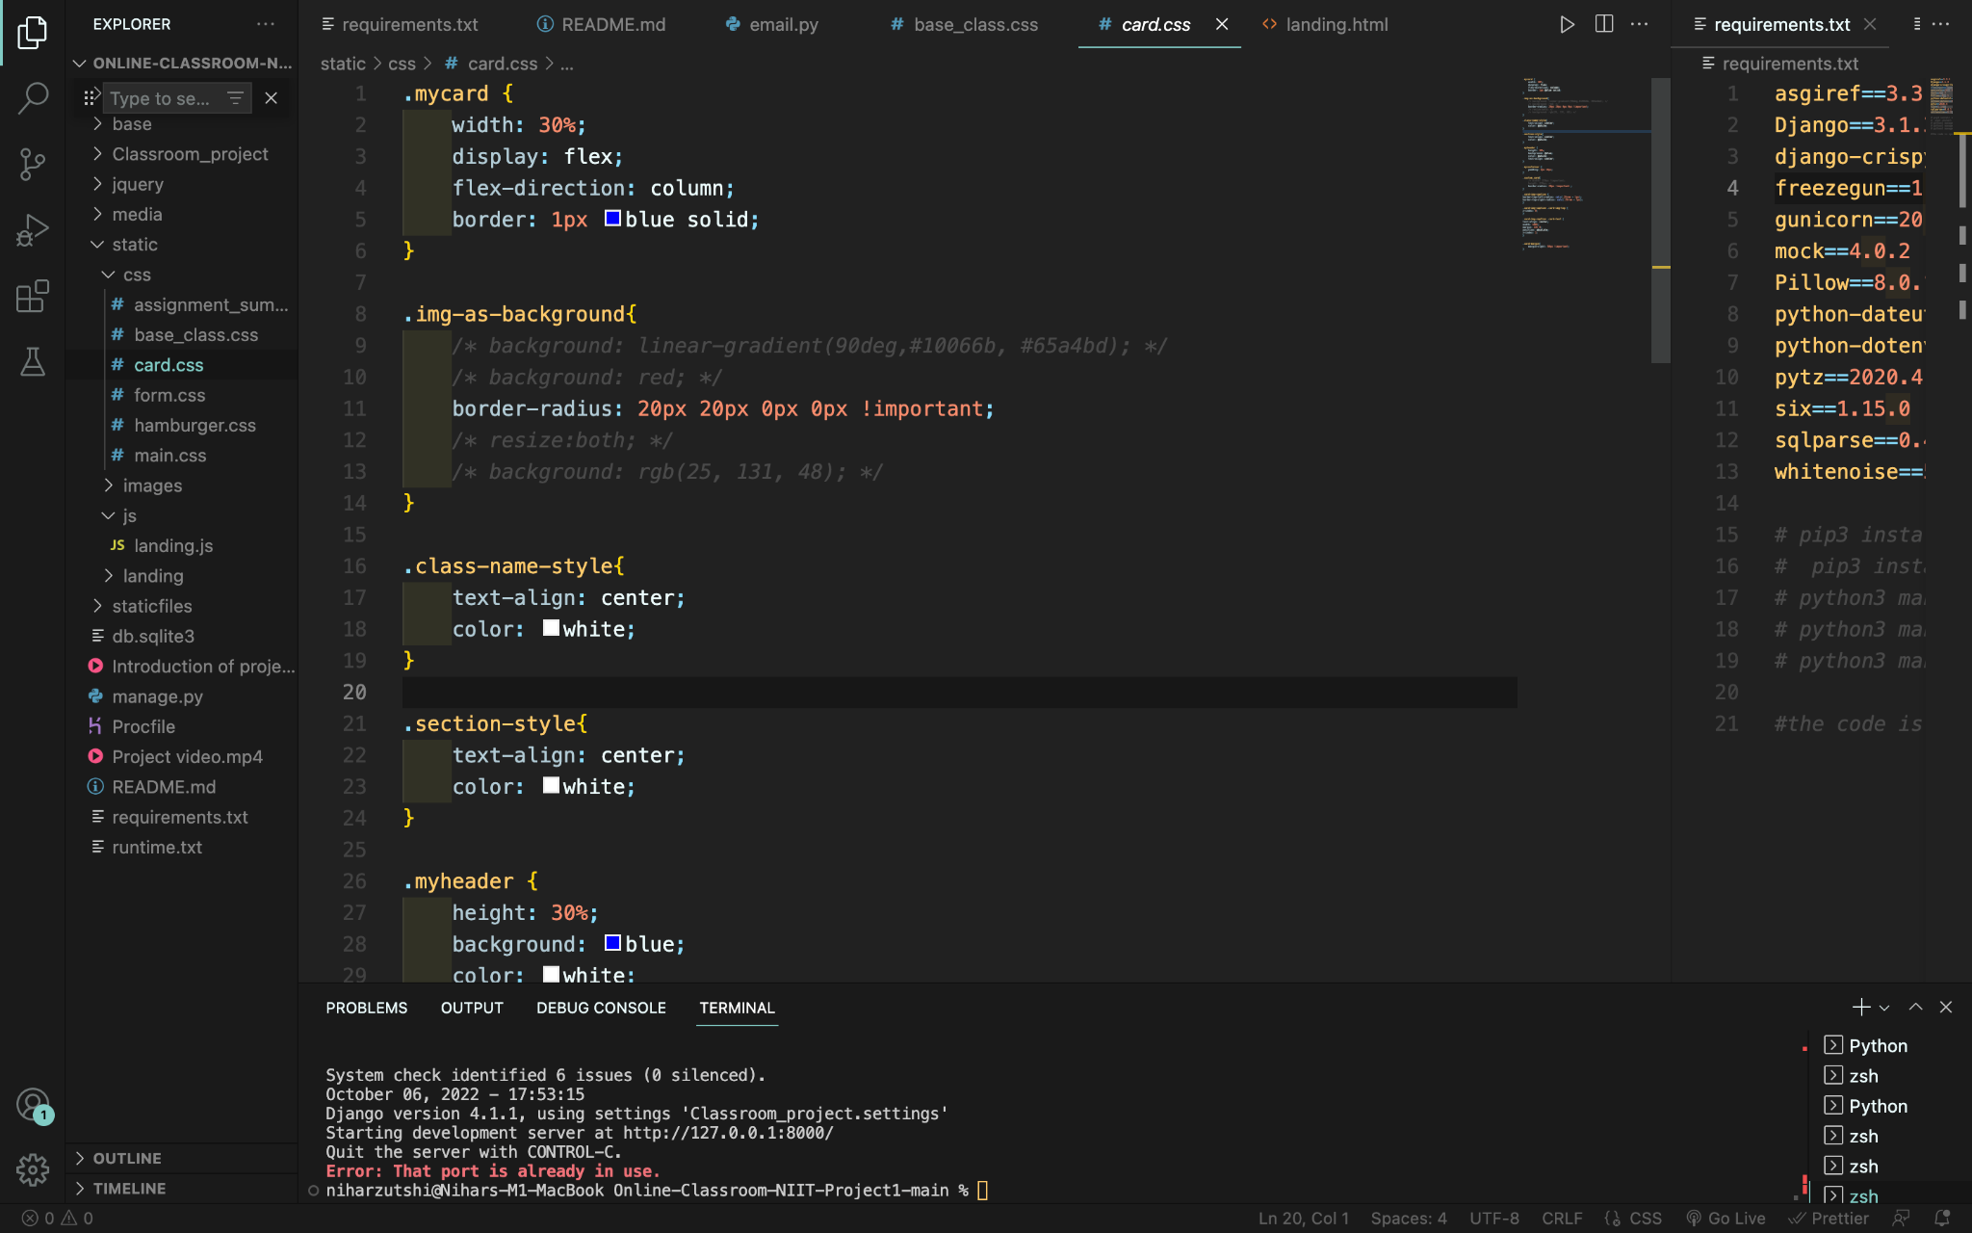
CODE

Slide 27
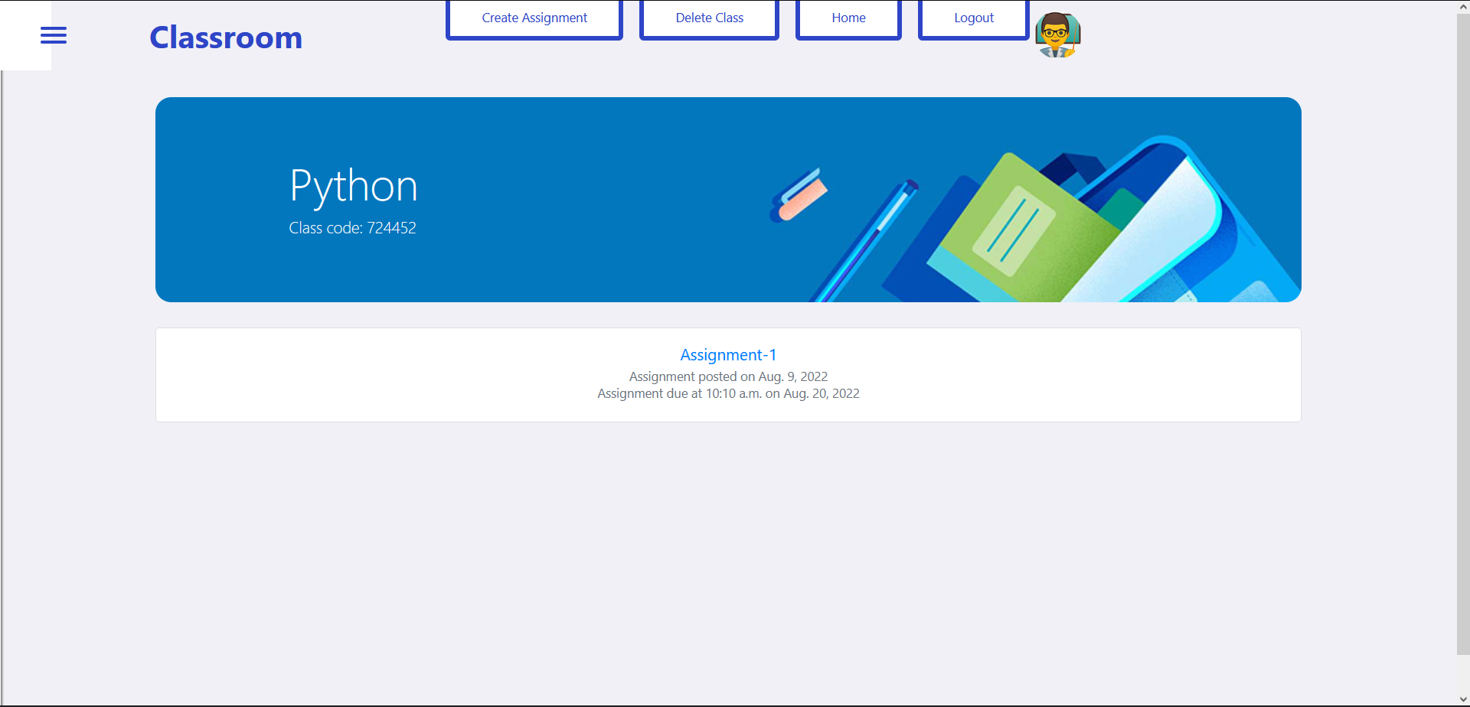
OUTPUT 1.1

Slide 28
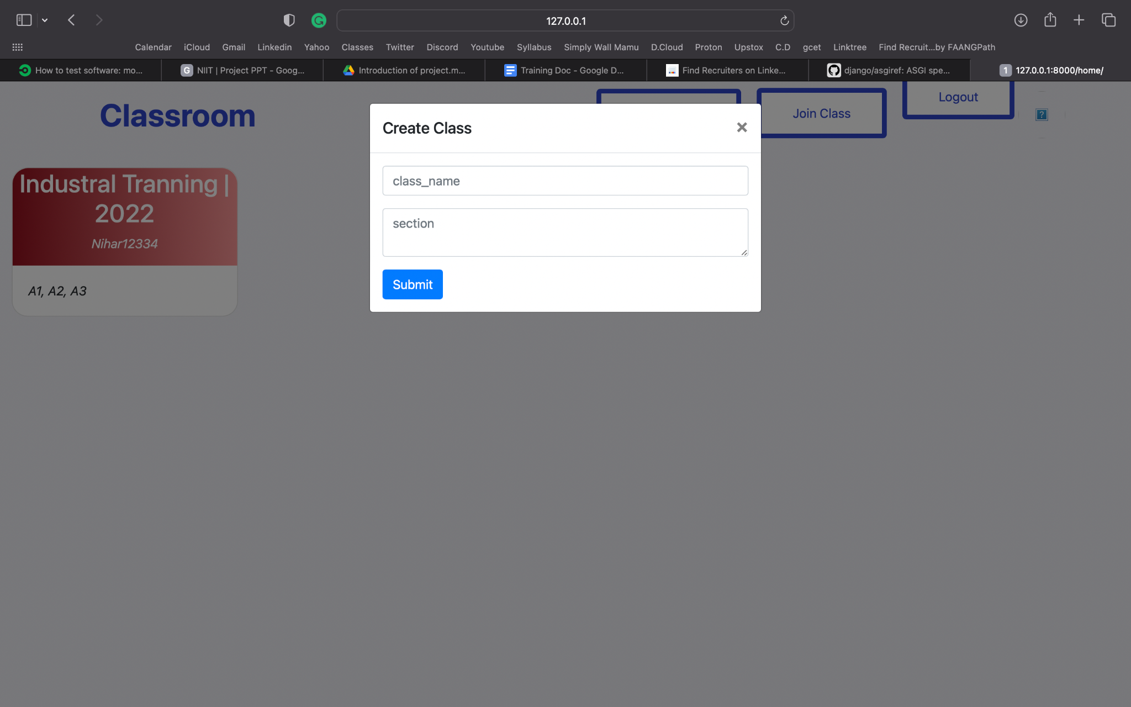
OUTPUT 1.1

Slide 29
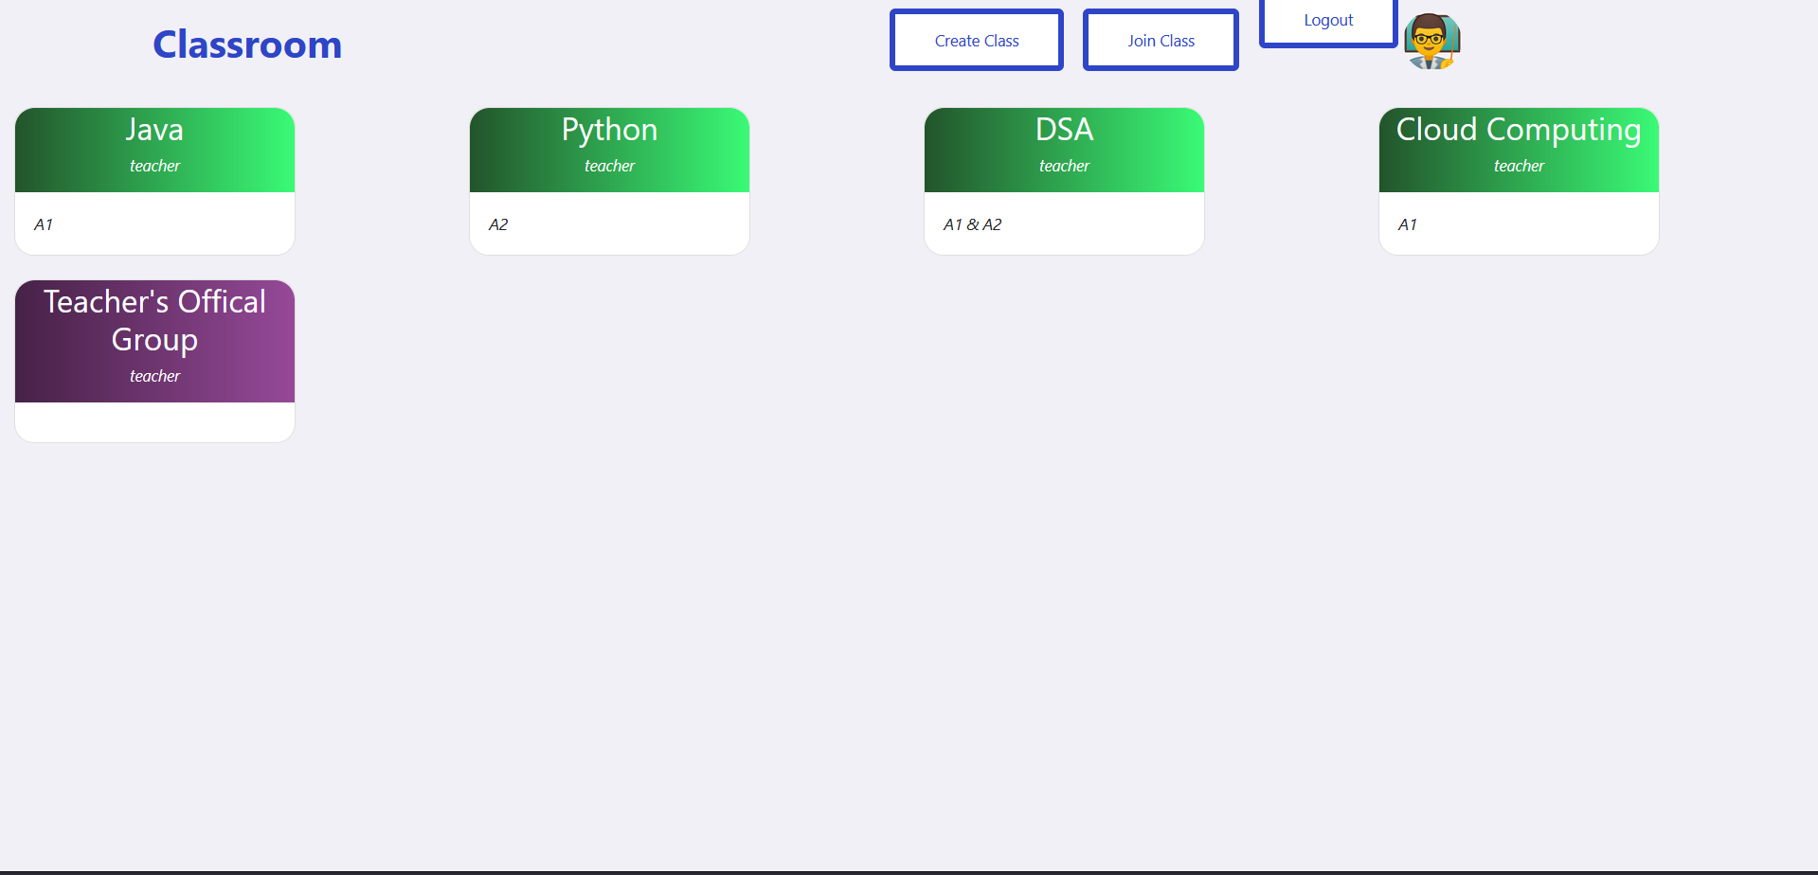

Slide 30
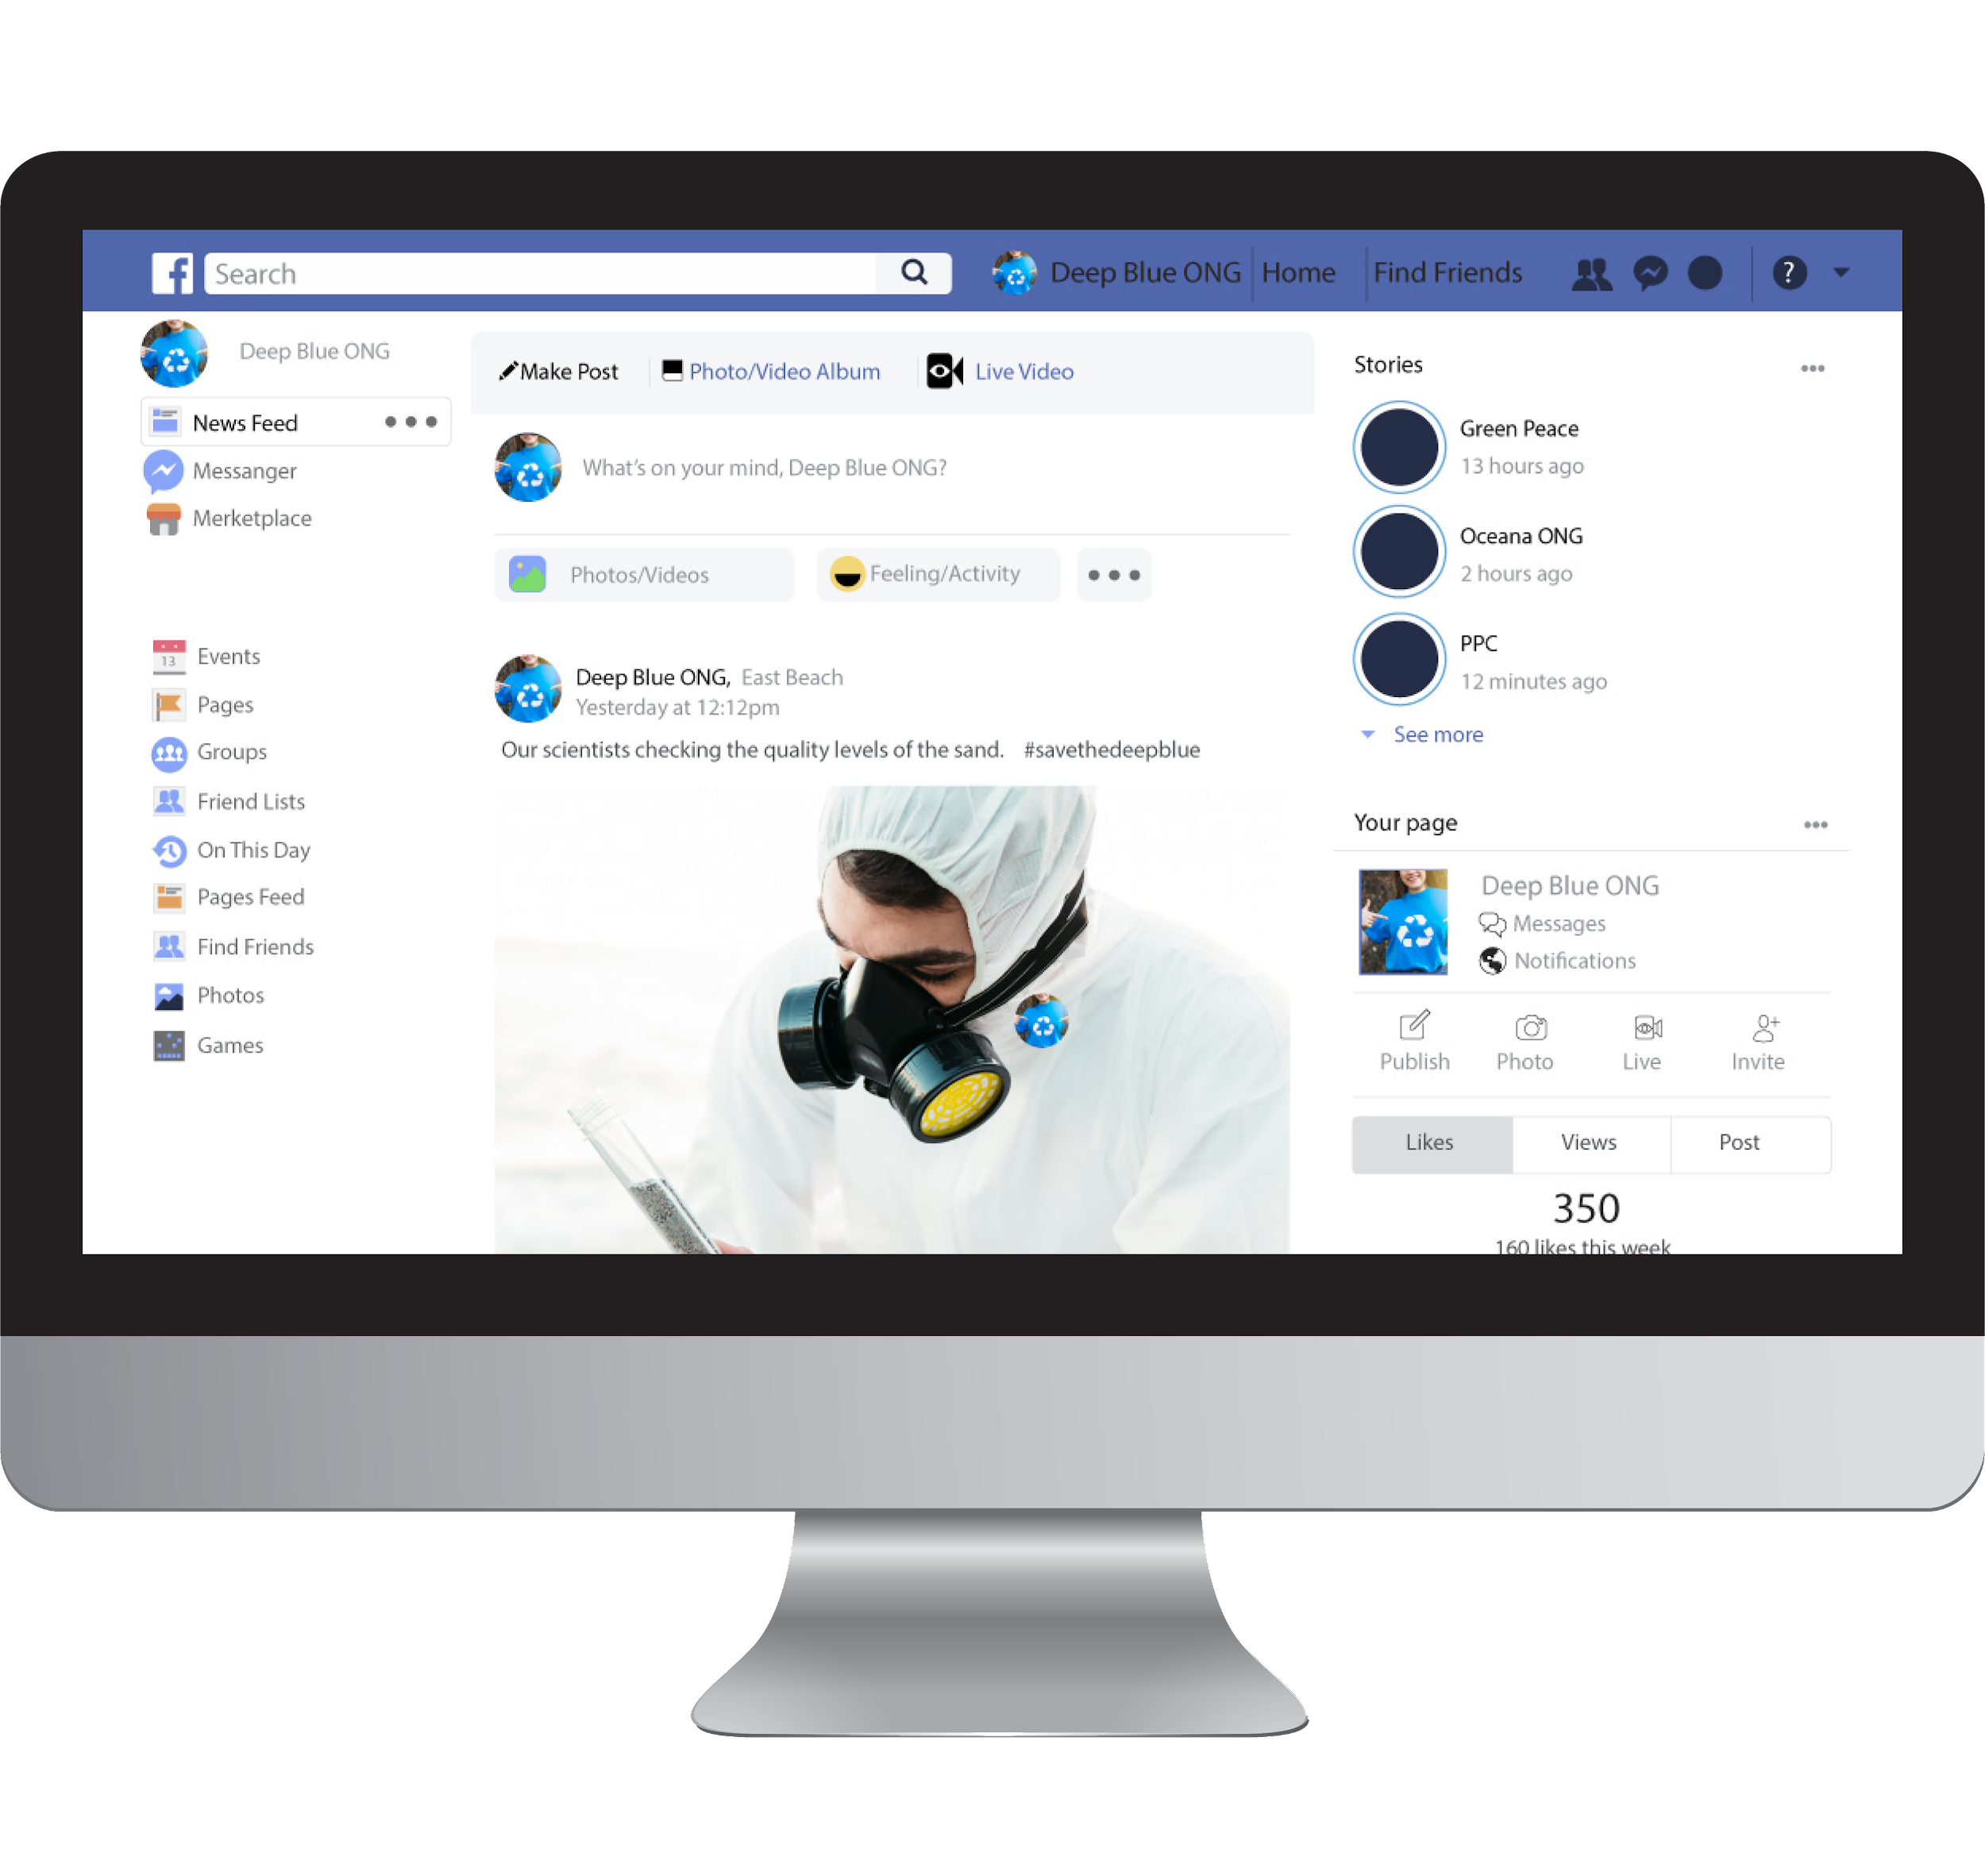

Project Video
Insert your multimedia content here

Slide 31


MEET OUR TEAM
🧿
🧿
“Alone we can do so little; together we can do so much”
“It takes two flints to make a fire”
Nihar Zutshi (He/Him)
Esha Bakshi (She/Her)

Slide 32

THANKS!
🧿
NIHAR ZUTSHI
nihar.49-cse-19@mietjammu.in
+91 849 38279 13
linkedin.com/niharzutshi

Slide 33

🧿

